Slide 1
Classifying Job Execution Using Deep Learning
Ashfaq Munshi, Saeed Bidhendi, Faramarz Munshi
March 6, 2018

Slide 2
Overview
Background and Motivation
Multivariate Time Series (MTS) Classification
Generalize Across Clusters
Conclusion

Slide 3
Background and Motivation

Slide 4
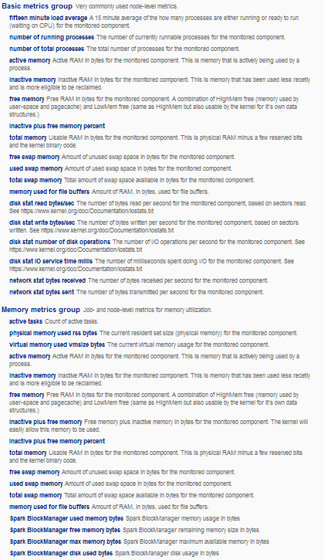
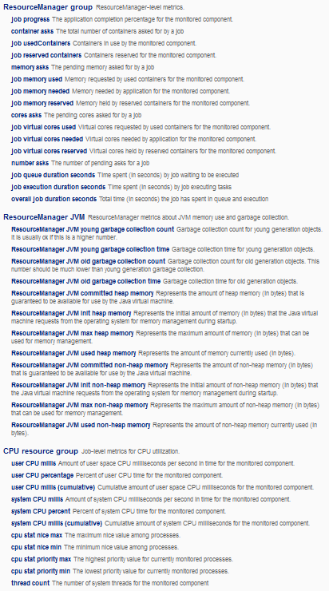
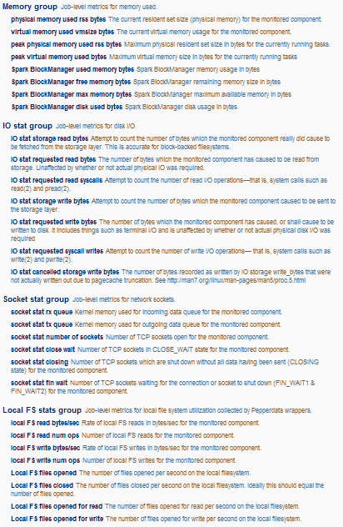
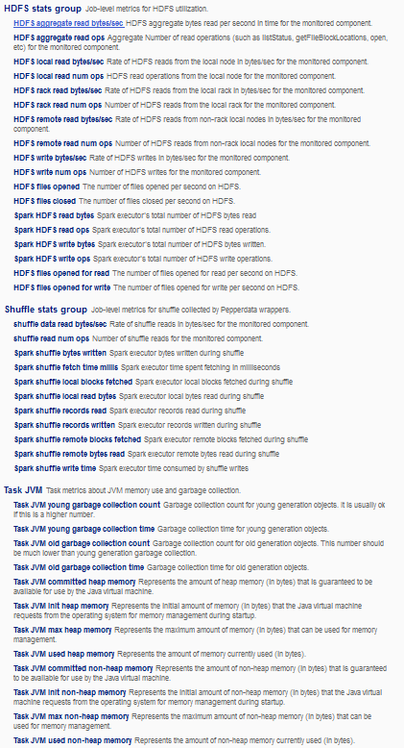
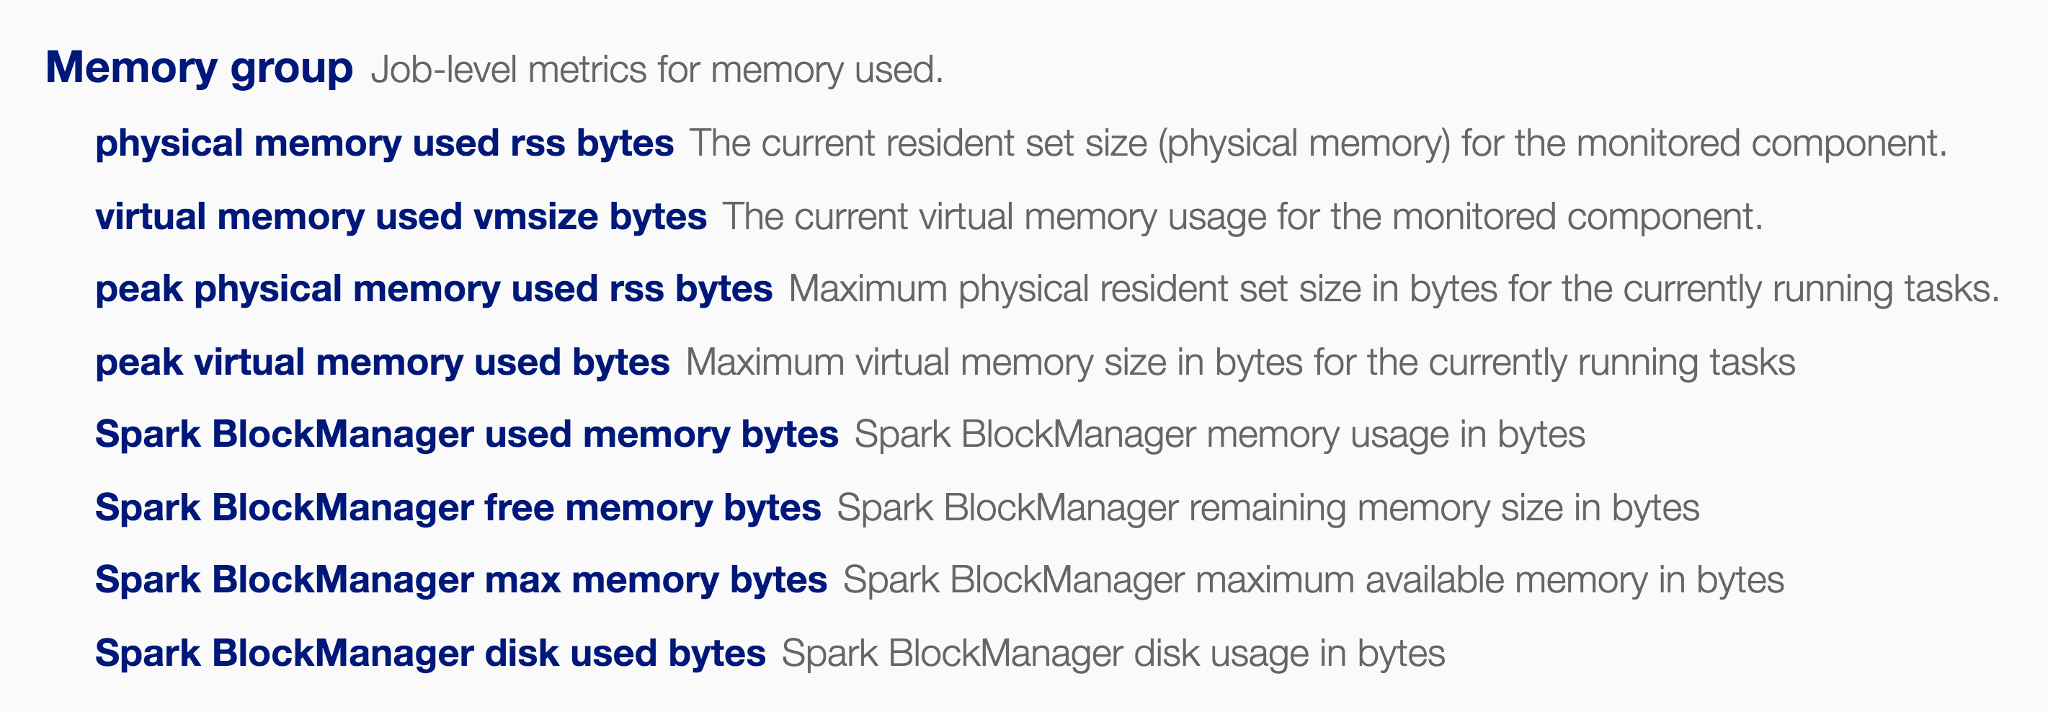
Code Analyzer
Application Profiler
Cluster Analyzer
Capacity Optimizer
Policy Enforcer

Slide 5
Pepperdata Telemetry Data Scale
Example production deployment:
570
Nodes
20
Tasks / Node
300
Metrics / Task
5-Sec Sampling
41 Million
Points / Minute
Notes:
Expedia cluster, 3/21-3/24. https://beta-dashboard.pepperdata.com/expedia-chandler-prod/charts#s=2017/03/21-13:07&e=2017/03/24-13:07&tzo=-7&m=basic

Slide 6
Our Big Data About Production Big Data
22 Thousand Production Nodes
50
Million Jobs/Year
300
Trillion Performance Data Points Collected

Slide 7
Problem
Build a model that labels jobs on any cluster into meaningful groups that are structurally similar

Slide 8
What is Structural Similarity?
Jobs that have similar time series for
CPU
Memory
Network
HDFS reads
Captures runtime characteristics and resource use

Slide 9
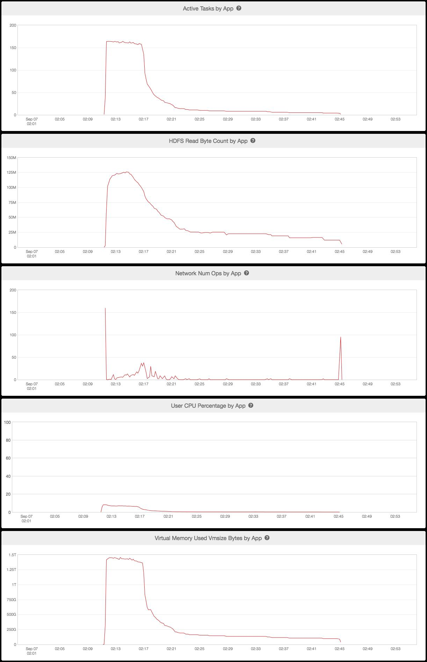
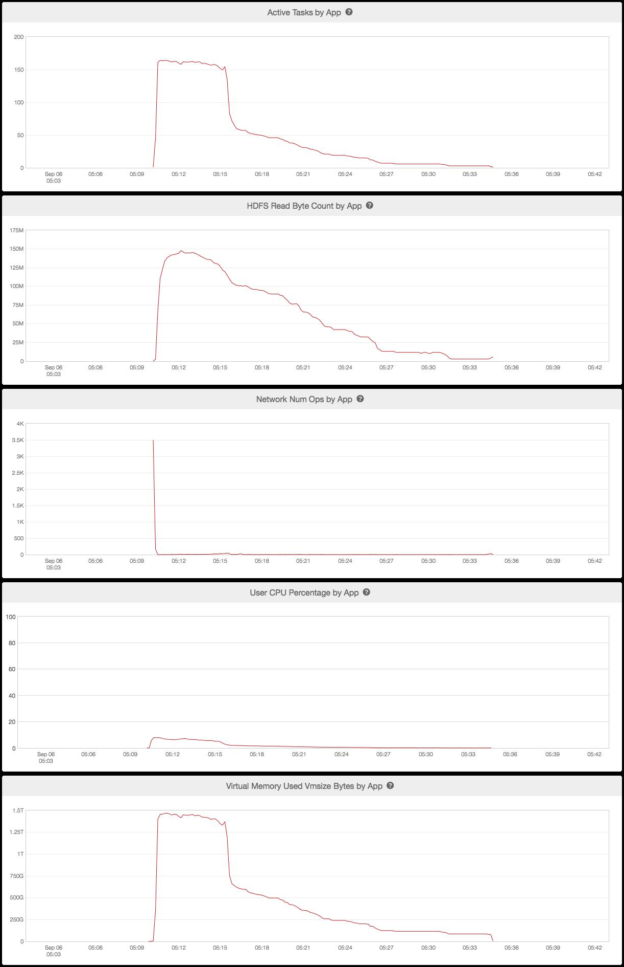
Example of Structural Similarity

Slide 10
Why?
Better scheduling
Queues
Hints for scheduler
Understanding job characteristics
Variations in run-time
Effects of queue assignments
Effects of hardware and system differences …
Compare jobs across different clusters

Slide 11
Our Approach
Build a deep learning model for job similarity
Essentially a multivariate time series classification problem (MTS)
Use customer labeled data as training data
Generalize across clusters
Merge labels across different customers
Generate a final set of labels across all clusters / customers

Slide 12
Multivariate Time Series

Slide 13
Previous Approaches
Two recent approaches from the literature
Use an ESN (“Echo State Network”) to map MTS into state clouds [Wang, Wang, Liu 2015]
Use Dynamic Time Warping with Mahalanobis distance metric [Mei, Liu, Wang, Gao 2016]
Dataset is from UCI, a small subset of UCR and others
Number of series ~ 10K
Data points per series ~ 200

Slide 14
Time Series and Images
Map the time series into
Gramian Angular Summation Fields
Gramian Angular Difference Fields
Markov Transition Fields
Feed images into a tiled CNN for classification
[Wang & Oats, 2015]

Slide 15
Gramian Angular Fields
Normalize the time series into [-1,1]
Transform to Polar Coordinates
[Wang & Oats, 2015]

Slide 16
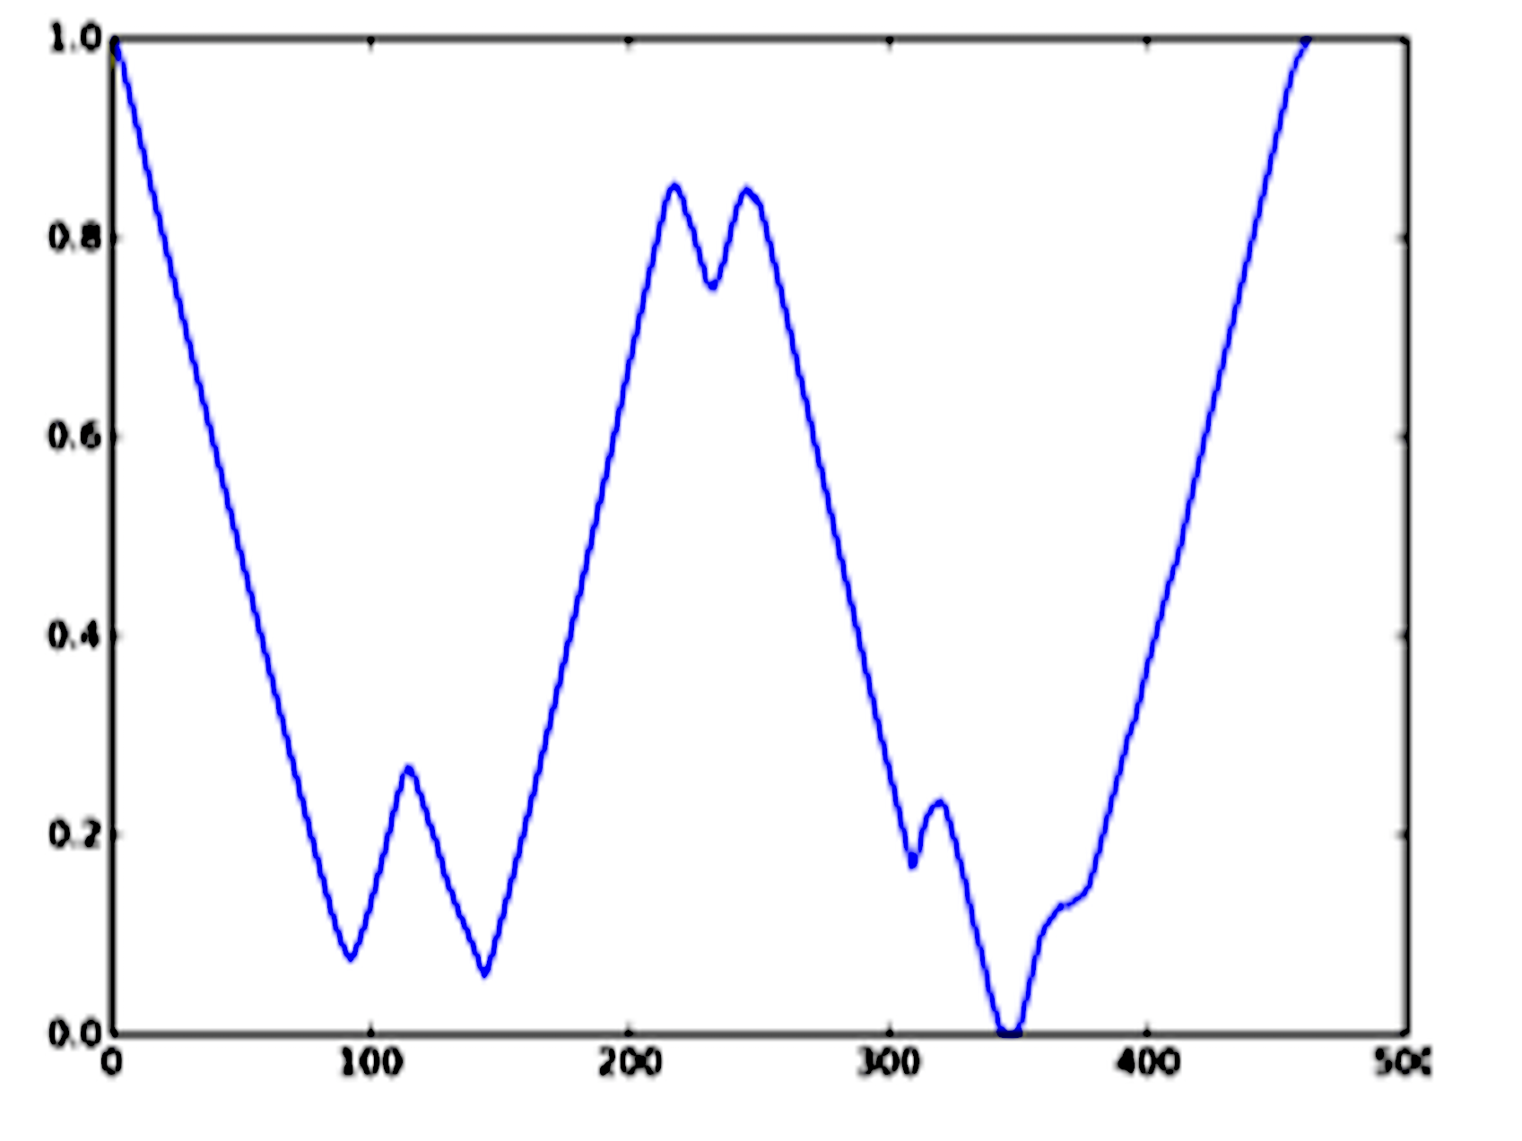
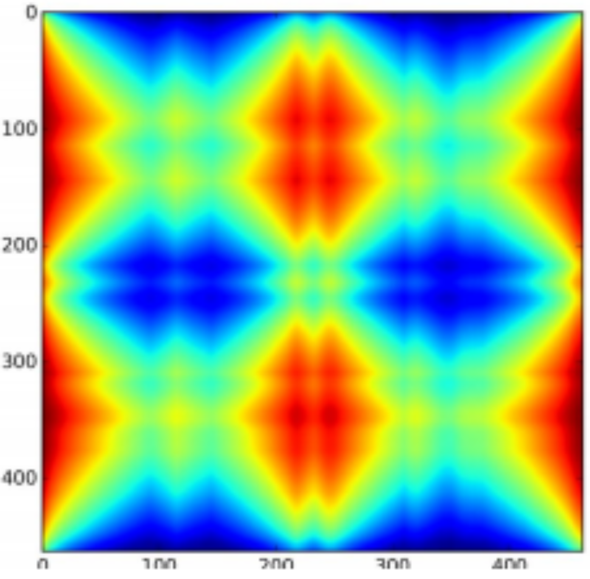
Example GADF Image
[Wang & Oats, 2015]

Slide 17
Our “Off the Shelf” Approach (PD)
Make TS for each variable the same length by zero padding
Convert each TS into a GADF image
Interpolate any missing data points in the image using linear interpolation on the image
Stack the images for the variables

Slide 18
Our “Off the shelf” Approach (PD)
Use Google’s pre-trained CNN; trained on inception v3
Embed into 2,048-dimensional vector space
Train MLP
2 hidden layers (50 nodes each)
ReLU activation
Dropout for regularization (.1, .2)
Softmax final layer

Slide 19
Training Time Comparison
■
PD

Slide 20
5-Fold Cross Validation Error

Slide 21
10-Fold Cross Validation Error

Slide 22
PD Data
Four variables:
CPU, Virtual Memory, HDFS reads, Network Ops
Each time series collected over one week
10 data points to 10K+ data points
Missing data
Extremely noisy
For periods longer than a week, data is much larger
Sampling rate is the same for all TS

Slide 23
Accuracy per Label on PD Dataset G
Number of TS = 3092
Lengths per TS = 5 to 8500
Average Accuracy = 78.14%

Slide 24
Accuracy per Label on PD Dataset R
Number of TS = 6715
Lengths per TS = 5 to 9400
Average Accuracy = 75.95

Slide 25
Generalizing Across Clusters

Slide 26
Problem
Given a set of labels for each cluster, generate a new set of labels that have high accuracy across all the clusters

Slide 27
Merging Algorithm
Input
Dataset1 with labels ‘A’, ‘B’
Dataset2 with labels ‘C’, ‘D’, ‘E’
Output
A unified set of labels across both datasets

Slide 28
Example
Dataset1 → labels: ‘A’ and ‘B’ , Dataset2 → labels: ‘C’ and ‘D’ and ‘E’
Label Dataset2 using A B
Dataset1 labels ( A , B ):
Label Dataset1 using C D E
Dataset2 labels ( C , D , E ):
C
C
C
C
E
D
C
C
D
E
C
D
E
D
D
D
AC
A*
BD
B*
A
A
A
A
AC, BD, A*, B*, BE
A
A
A
A
B
A
A
A
B
B
B
B
B
B
B
B
B
CA
CB
DA
DB
EA
EB
AC
B*
A*
BE

Slide 29
Model Performance on Merged PD Datasets
Label | Accuracy
1 | 100%
2 | 100%
3 | 100%
4 | 100%
5 | 98.61%
6 | 98.46%
7 | 97.23%
8 | 96.43%
Label | Accuracy
9 | 94.45%
10 | 92.45%
11 | 92.31%
12 | 92.21%
13 | 91.67%
14 | 90.82%
15 | 88.89%
16 | 87.88%
Label | Accuracy
17 | 87.76%
18 | 84.91%
19 | 83.34%
20 | 82.61%
21 | 81.48%
22 | 81.07%
23 | 80.31%
24 | 77.80%
Label | Accuracy
25 | 77%
26 | 76.59%
27 | 76%
28 | 75.60%
29 | 75.34%
30 | 74.47%
31 | 74.45%
….. | …...

Slide 30
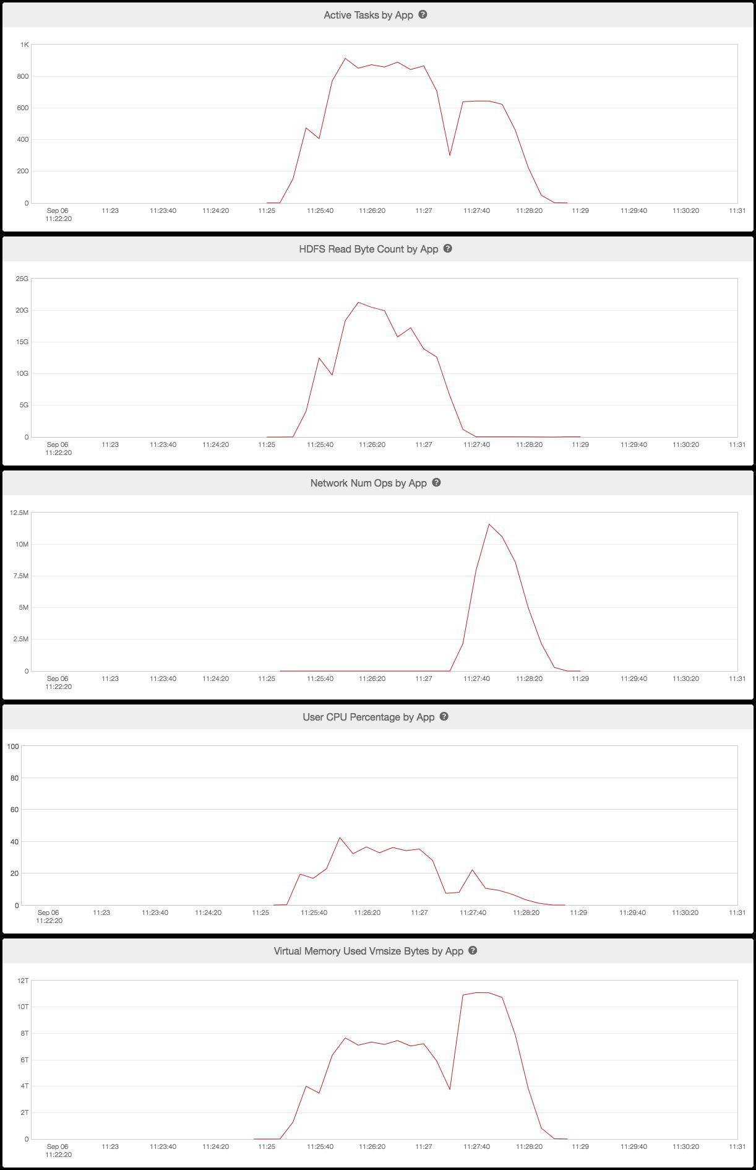
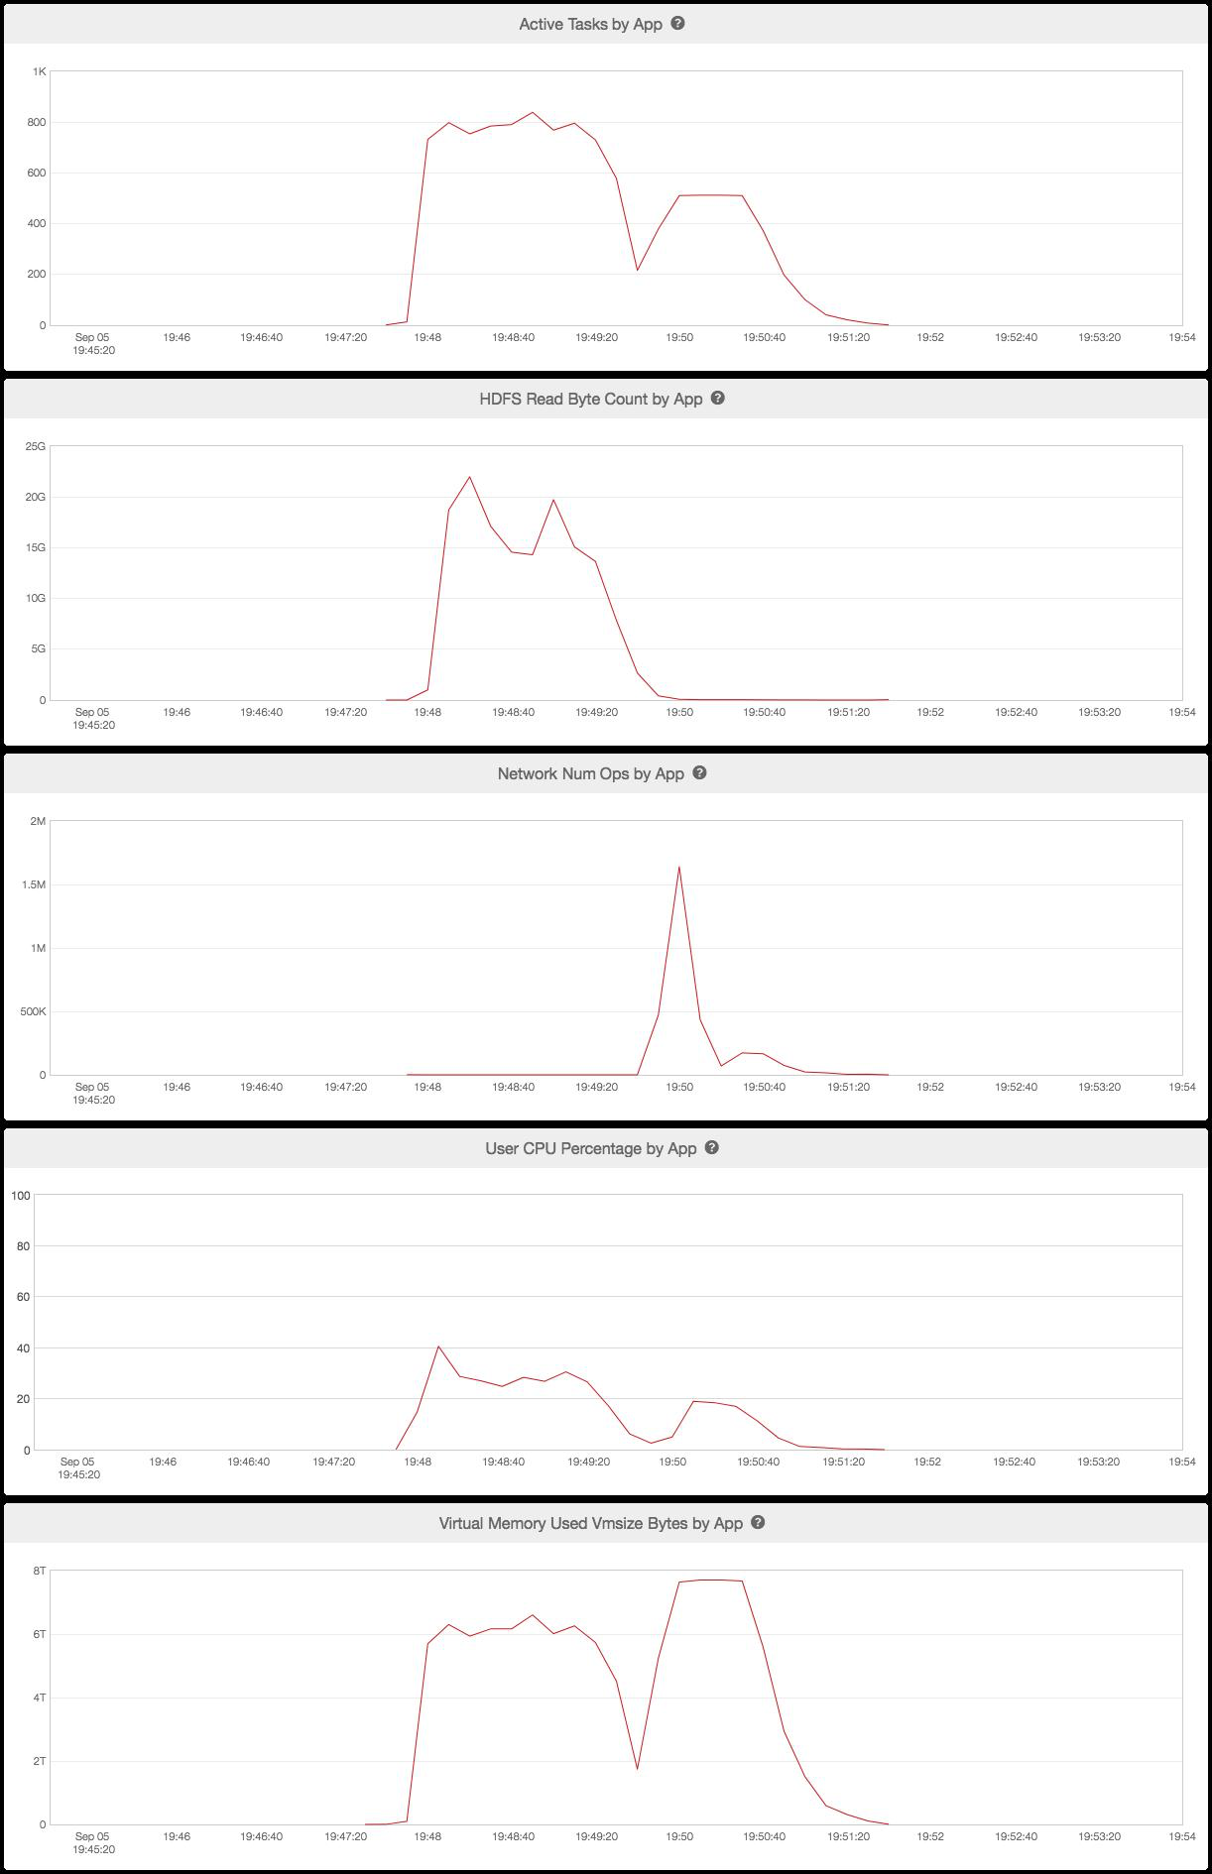
Structures within a cluster
‘check_data’
‘Insert_overwrite_table’

Slide 31
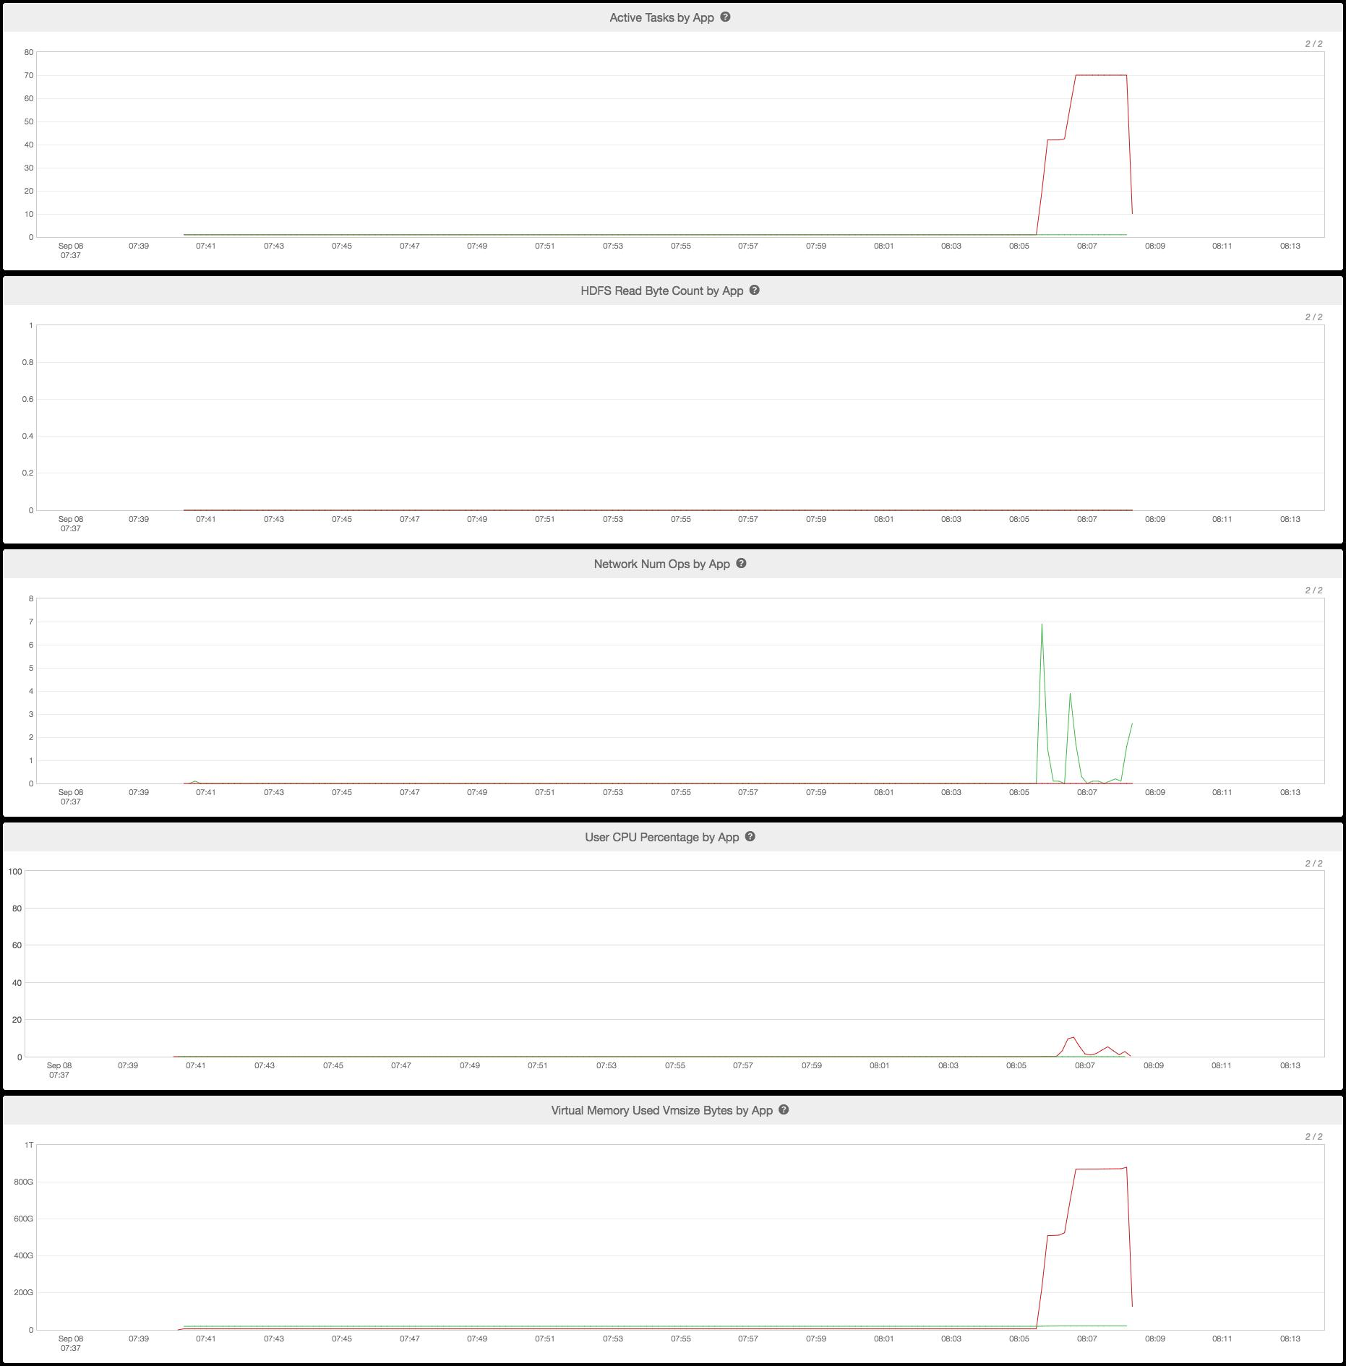
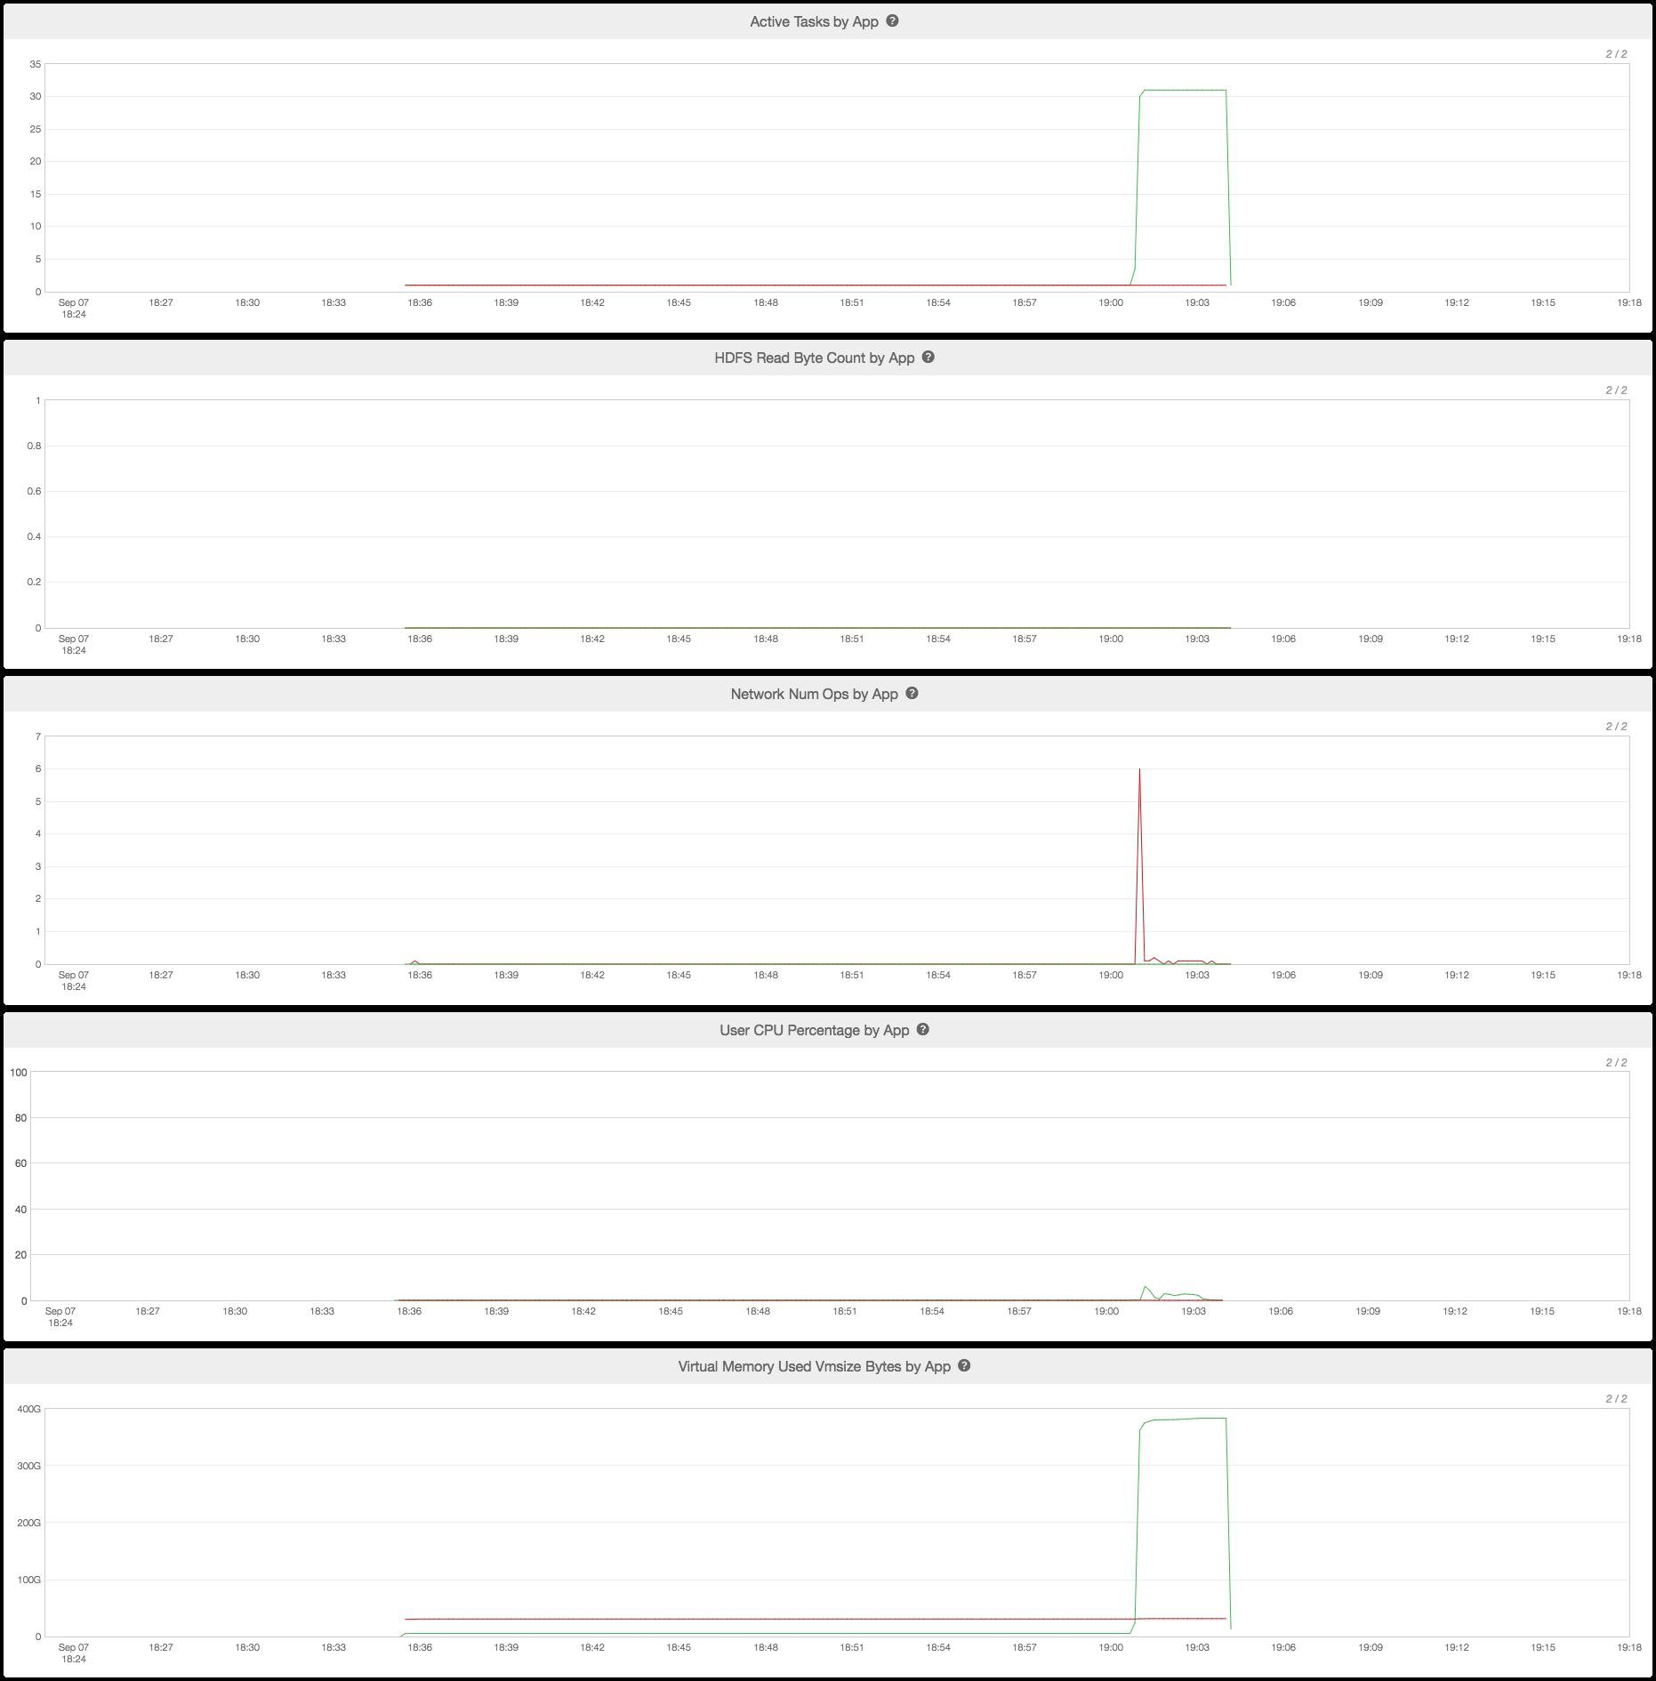
Structures within a cluster

Slide 32
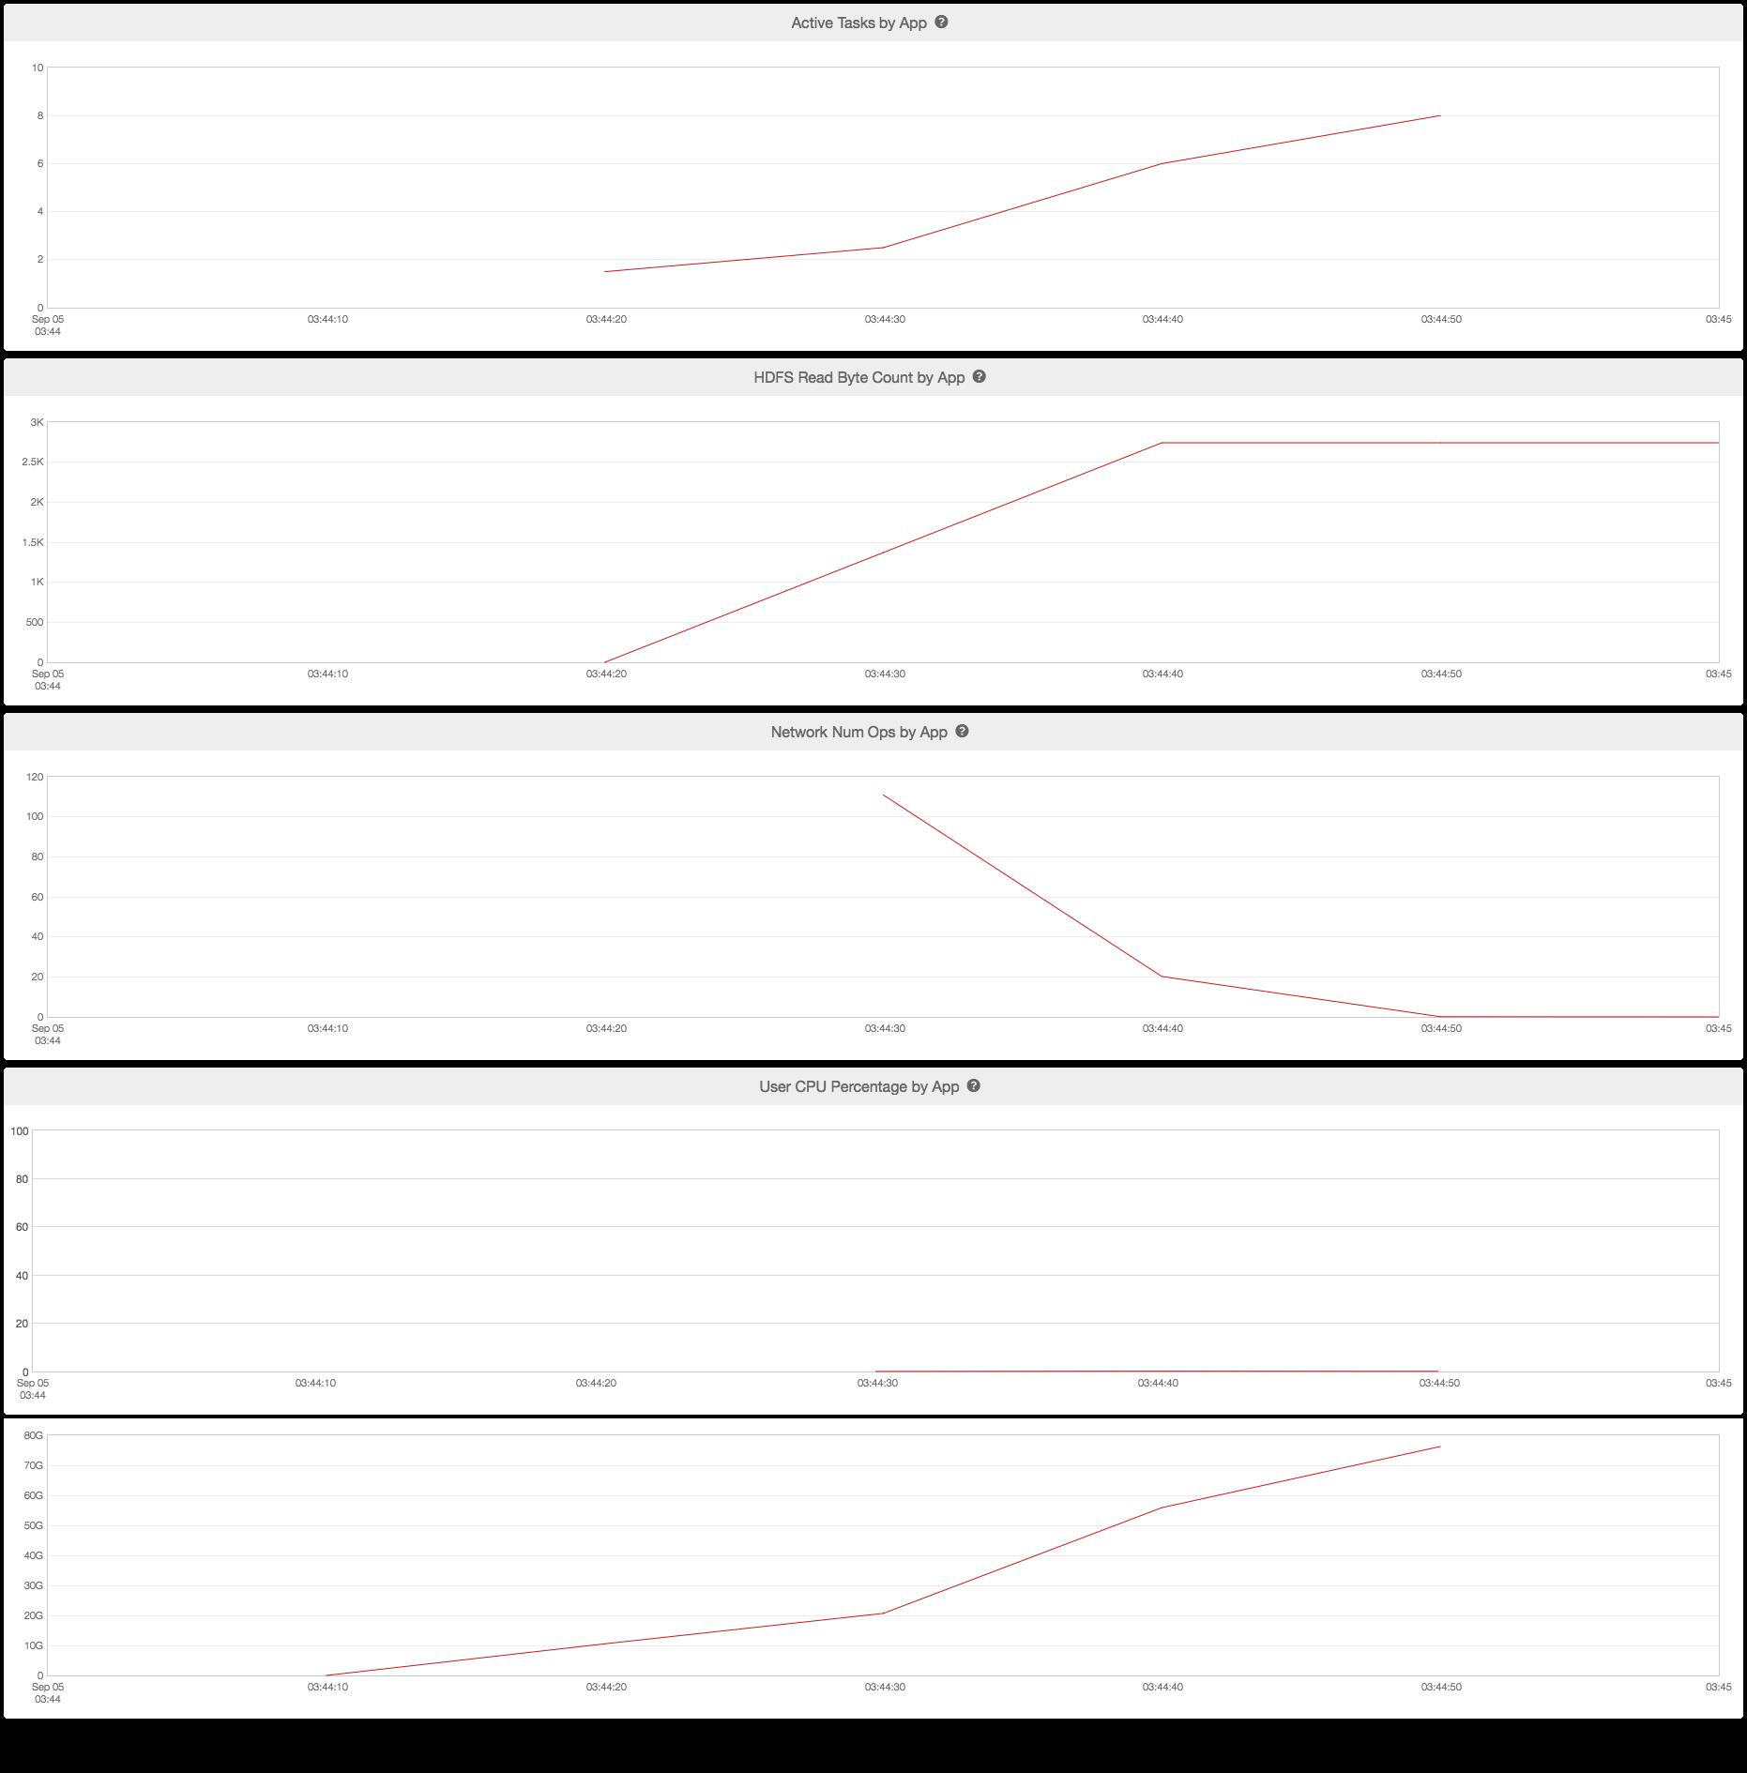
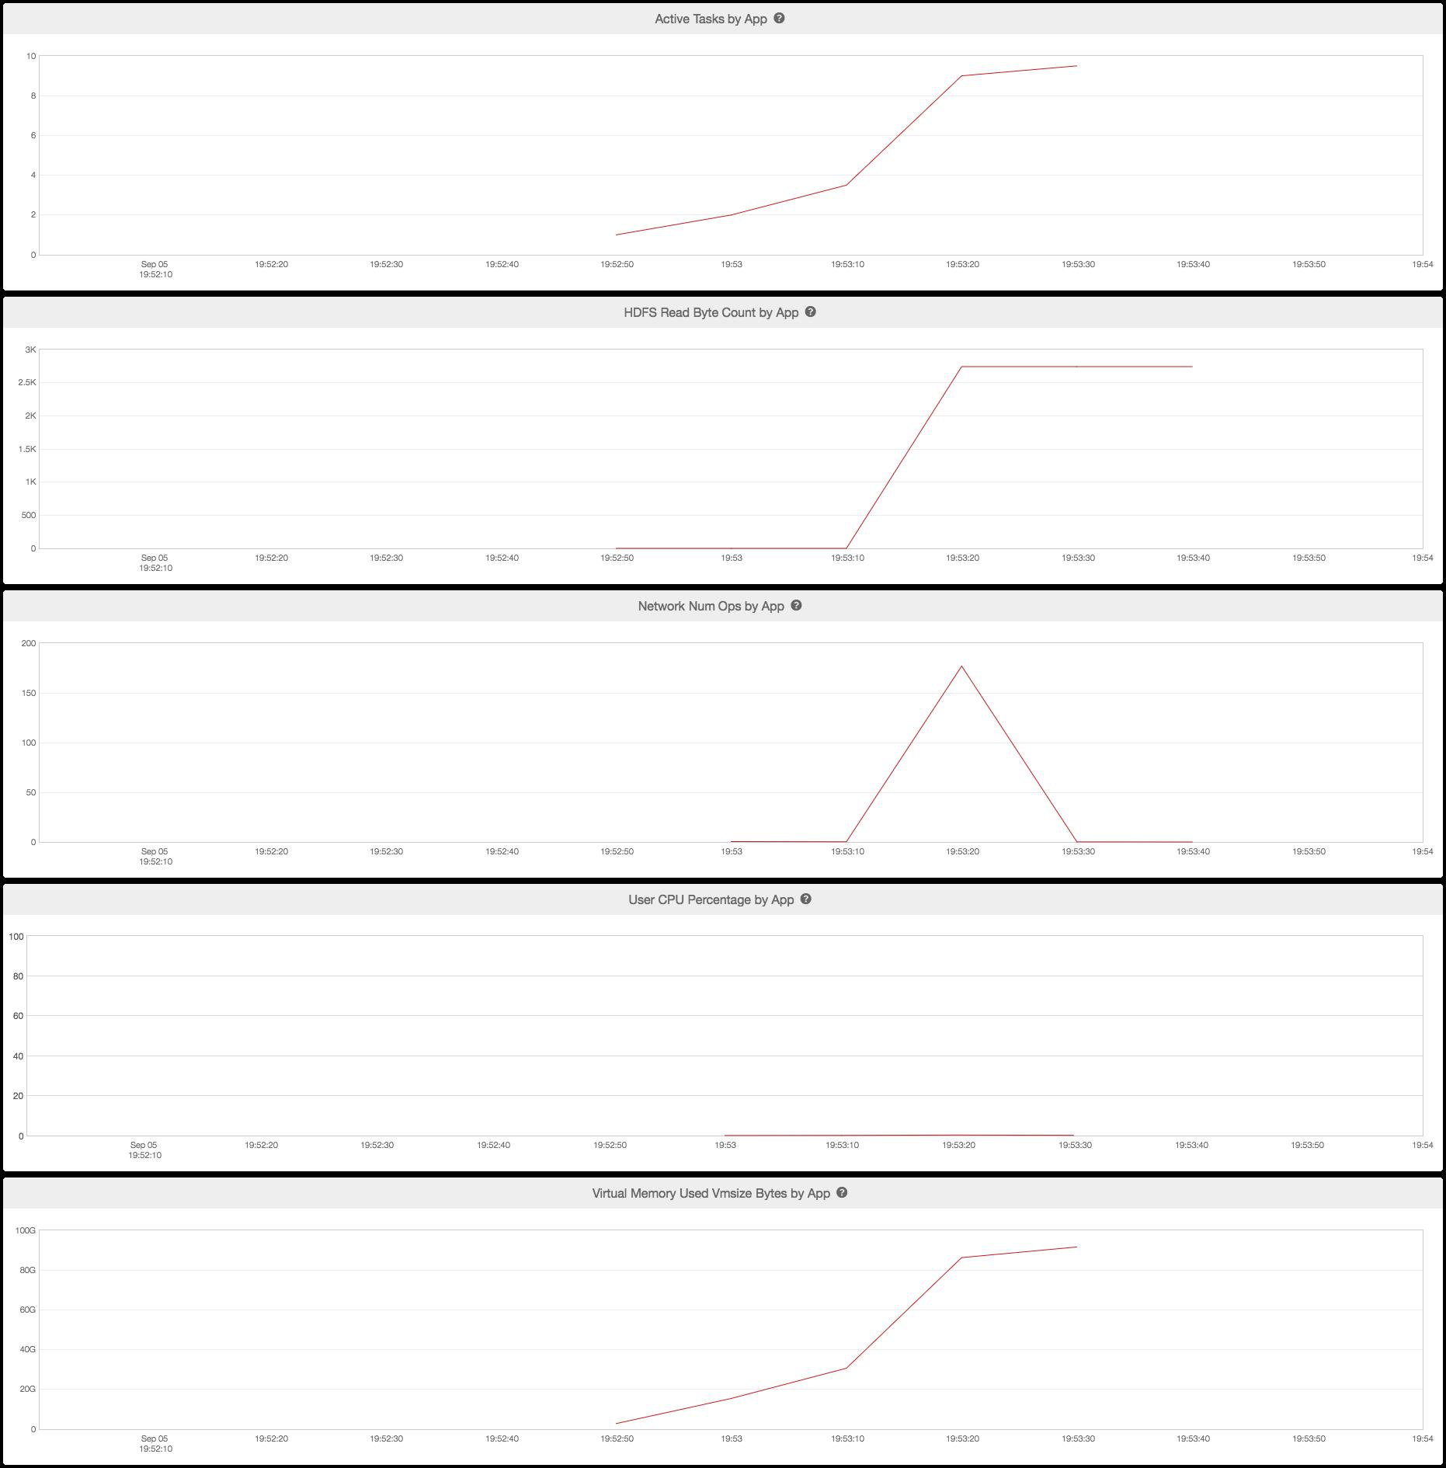
Structures between clusters

Slide 33
Results
Across all of PD customer clusters 44 labels have accuracy over 50% using merge algorithm

Slide 34
Next Steps
Do these 44 labels really describe distinct job types on Big Data clusters? If so, what does this imply for scheduling and resource allocation?

Slide 35
Thank You

